Slide 1
ECM LATHE
Simon Popecki Carlos Graniello
TURBOCAM International University of New Hampshire

Slide 2
Electrochemical Machining - Benefits
ECM is reverse electroplating
Non-contact (can be used for hard materials)
For conductive materials (including some cermets)
No heat affected areas or distortion to the part – machining force low
No tool wear
Excellent surface quality – can be used as a finishing process
High dimensional accuracy
Commonly used to manufacture superalloy flow path components

Slide 3
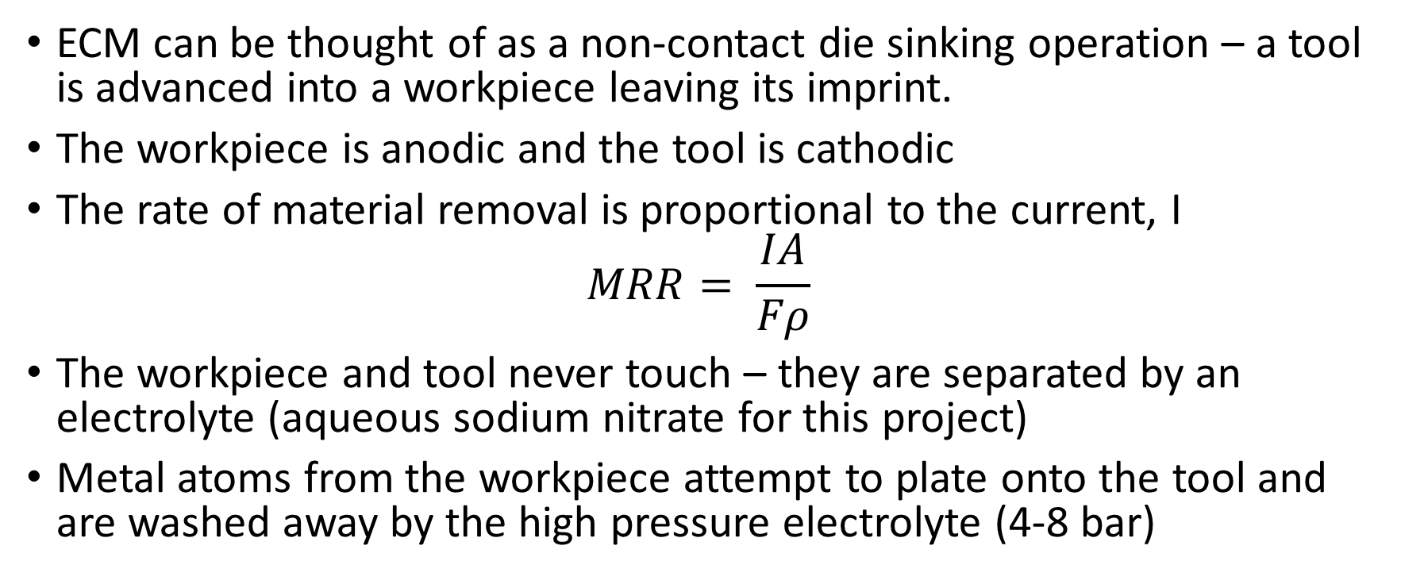
ECM Fundamentals
ECM can be thought of as a non-contact die sinking operation – a tool is advanced into a workpiece leaving its imprint.
The workpiece is anodic and the tool is cathodic
The rate of material removal is proportional to the current, I
$$MRR= \frac{IA}{Fρ}$$
The workpiece and tool never touch – they are separated by an electrolyte (aqueous sodium nitrate for this project)
Metal atoms from the workpiece attempt to plate onto the tool and are washed away by the high pressure electrolyte (4-8 bar)

Slide 4
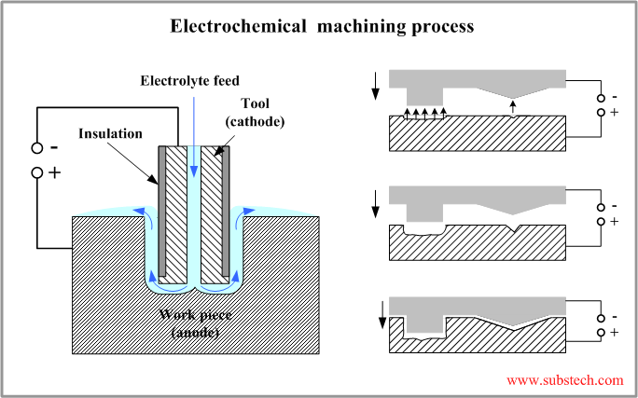

Slide 5
Design Objectives Completed
Acquire and assemble conventional lathe as base
Acquire motors and electronics
Create CAD model of system in its current state
Program lathe allowing for precise, repeatable motion (repeatability measured to be .001”)
Modify location of lathe’s spindle by addition of a custom made part
Design machining enclosure
Write a G-Code interpreter to compile operator commands into precise movements (currently fine tuning software)

Slide 6
G-Code Interpreter – Supported Commands
G00 – Rapid move*
G01 – Controlled move*
G02 – Clockwise Arc*
G03 – Counter Clockwise Arc*
G04 – Dwell*
G90 – Absolute coordinates mode
G91 – Relative coordinates mode
G92 – Reset origin
G100 – Motor test function (pre-programmed move)
M17 – Enable, and initialize stepper drivers to pre-programmed settings
M18 – Disable stepper drivers (saves electricity – 17 W)
M100 – Show a list of G-Codes and M-Codes
M114 – Display current position, federate, and coordinate system (relative or absolute)

Slide 7
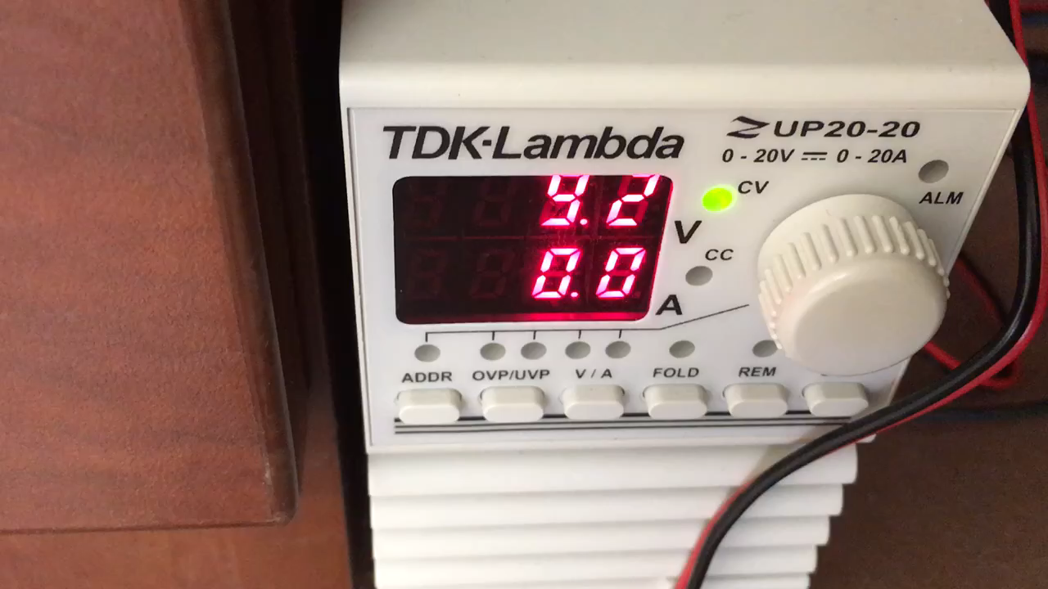
Stepper Enable, Disable, and Movement

Slide 8
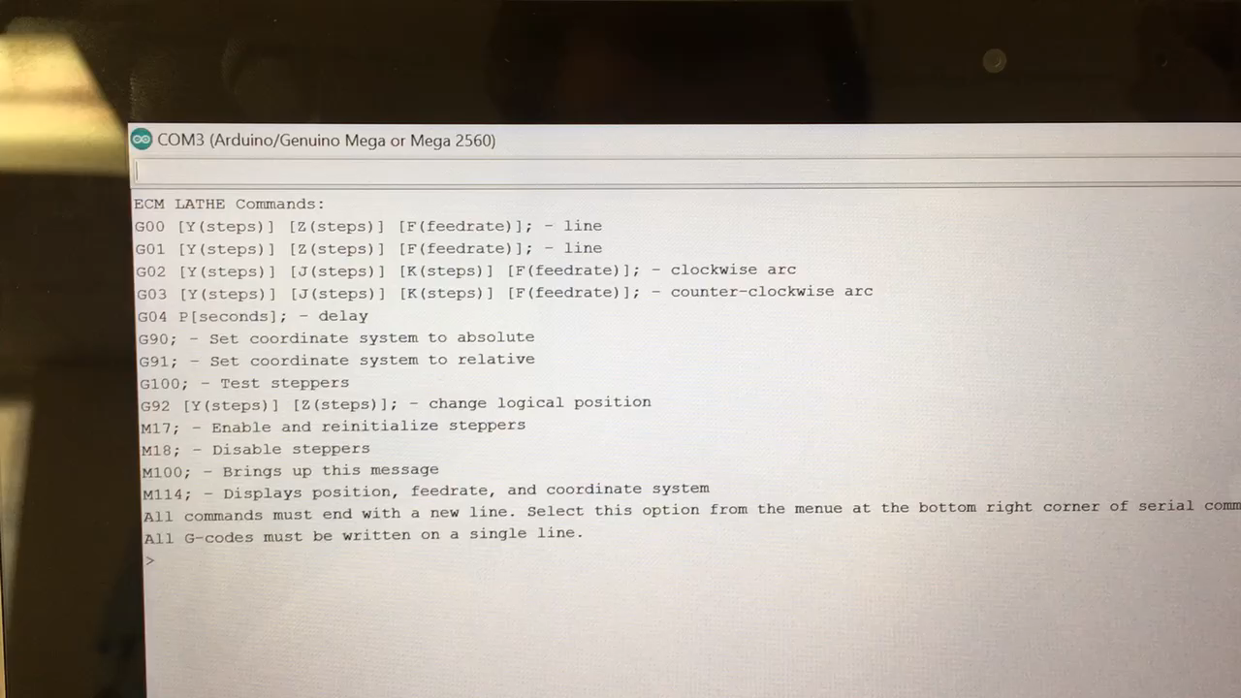
Switching Between Coordinate Systems

Slide 9
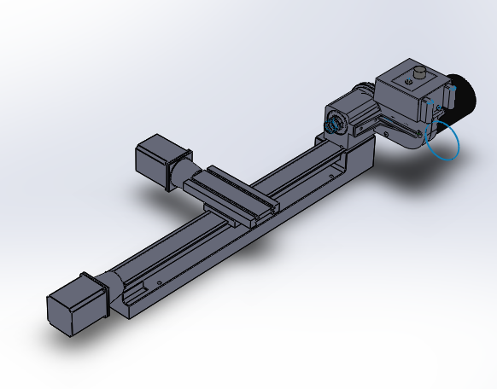
Lathe Out of the Box (Non-Modified Assembly)

Slide 10
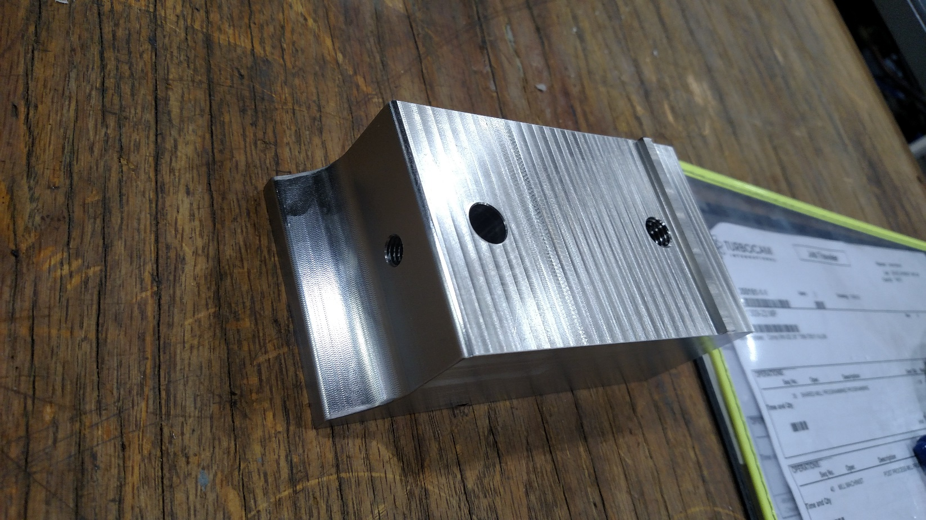
Introducing the Spindle Extension

Slide 11
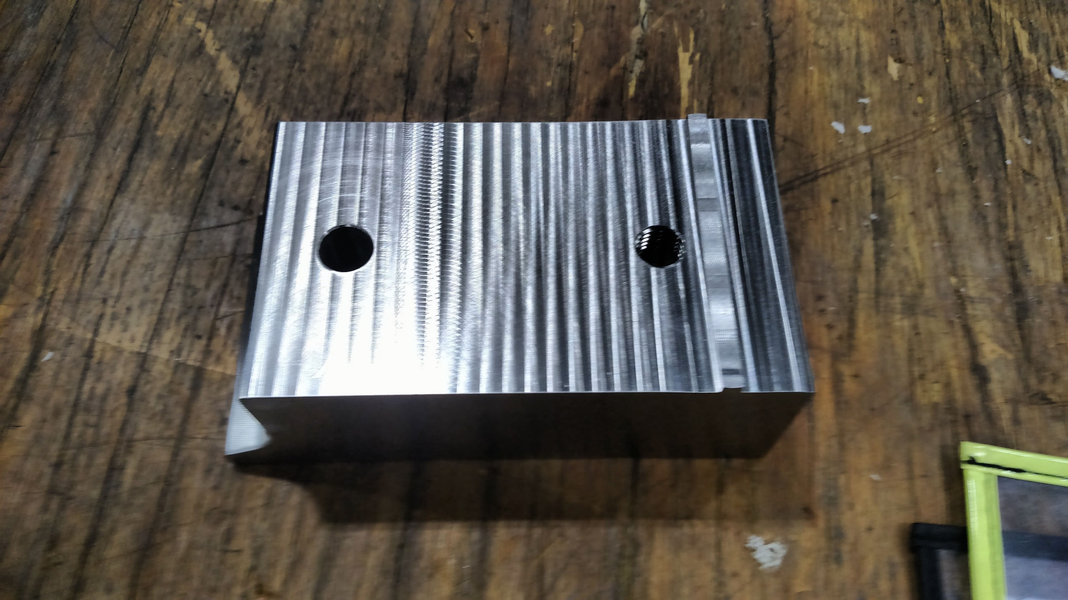
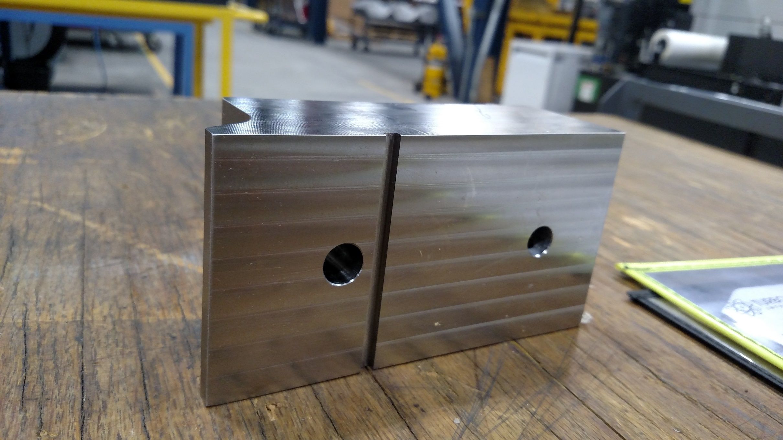
Extension
Properties:
304 Stainless Steel
145x51 mm
8.5 lb
Thread Per Inch.
1/2-13 Coarse Thread Series UNC
3/8-16 Coarse Thread Series UNC

Slide 12
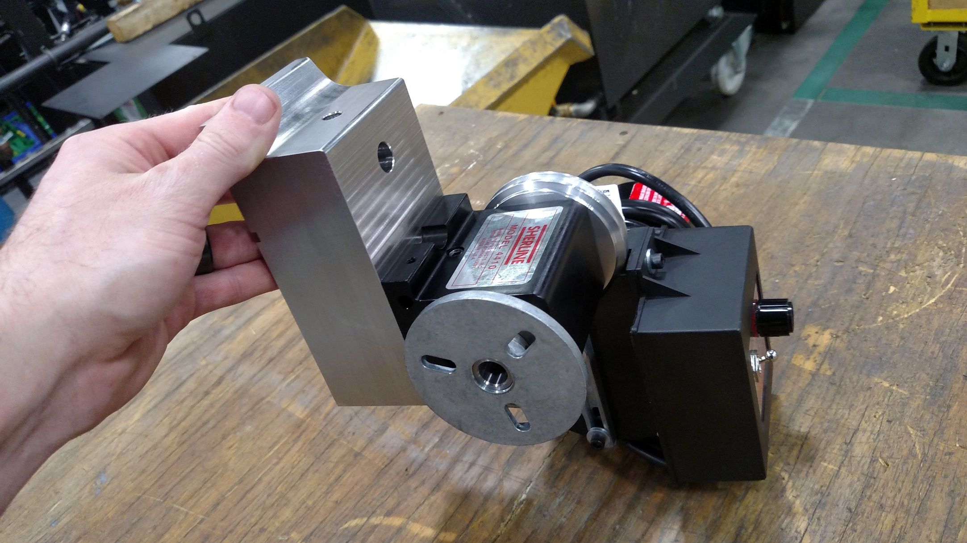
Spindle Extension In Position

Slide 13
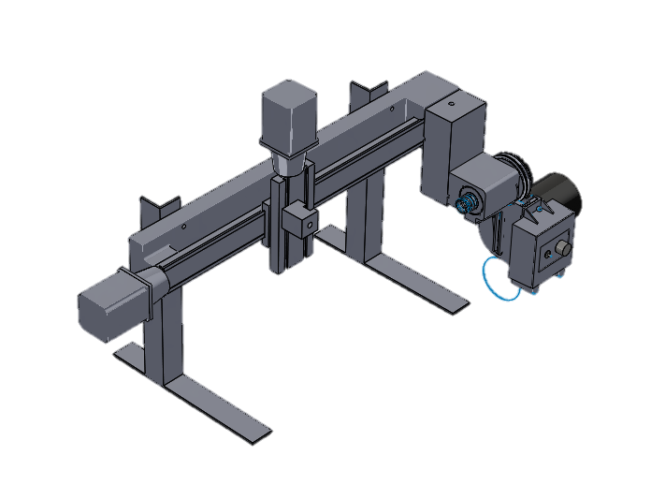
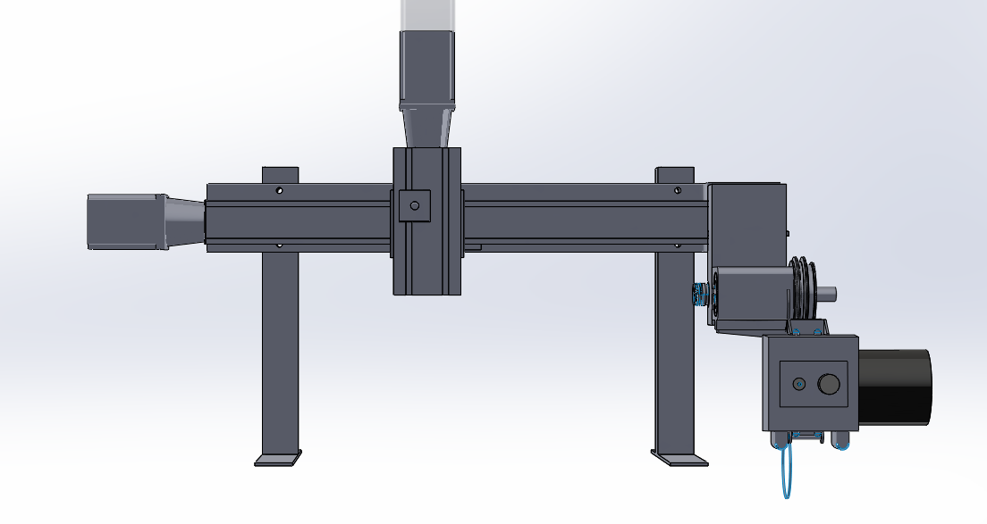
Modified Assembly (For ECM Setup)

Slide 14
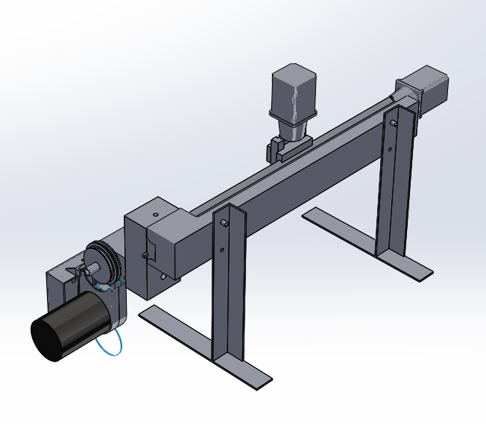
Assembly Supports

Slide 15
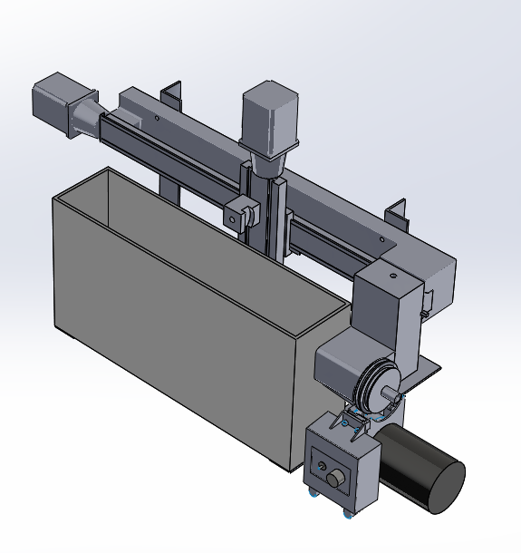
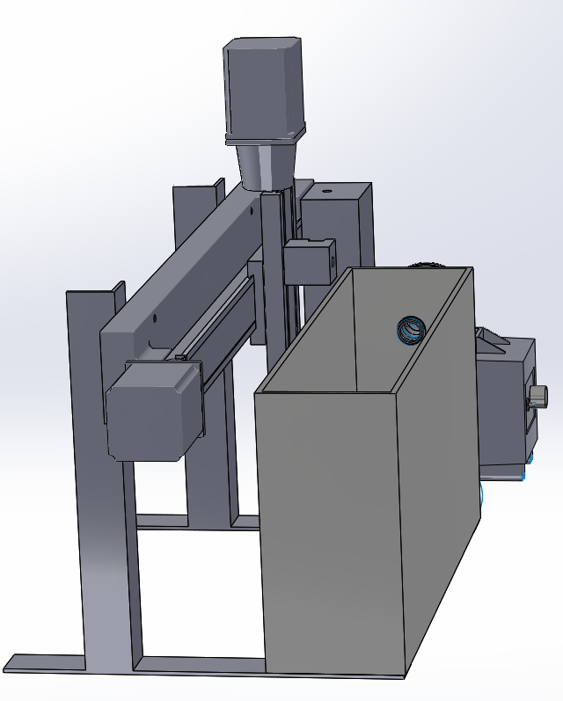
Machining Enclosure With Assembly

Slide 16
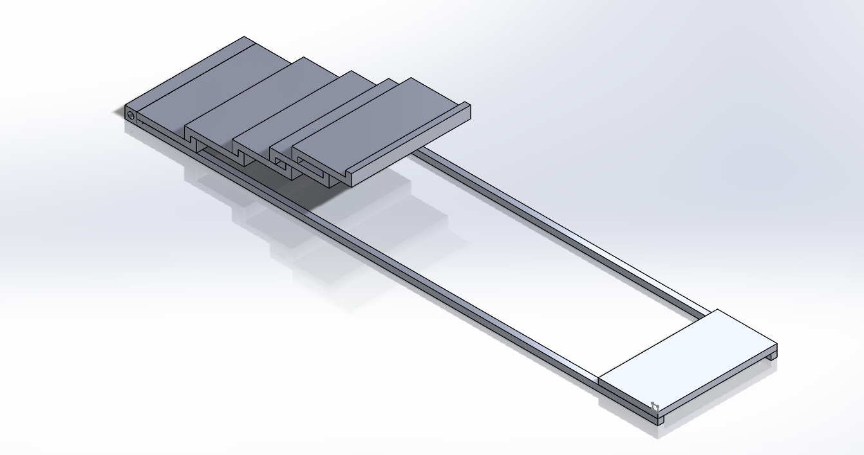
Idea to Seal Enclosure

Slide 17
Further Steps
Build Machining Enclosure from existing design
Use TURBOCAM power supply (MUNK supply) and EMS (Barrington 2 Electrolyte Management System) until second semester
Supply power to the rotating anodic workpiece
Build cathodes (a few completed designs exist already)
Supply and evacuate electrolyte to the machining enclosure

